Slide 1

Smart Urban Community Resilience
Agentic, Auditable, Always-On
Syed M. Ashhar 29 October 2025

Slide 2
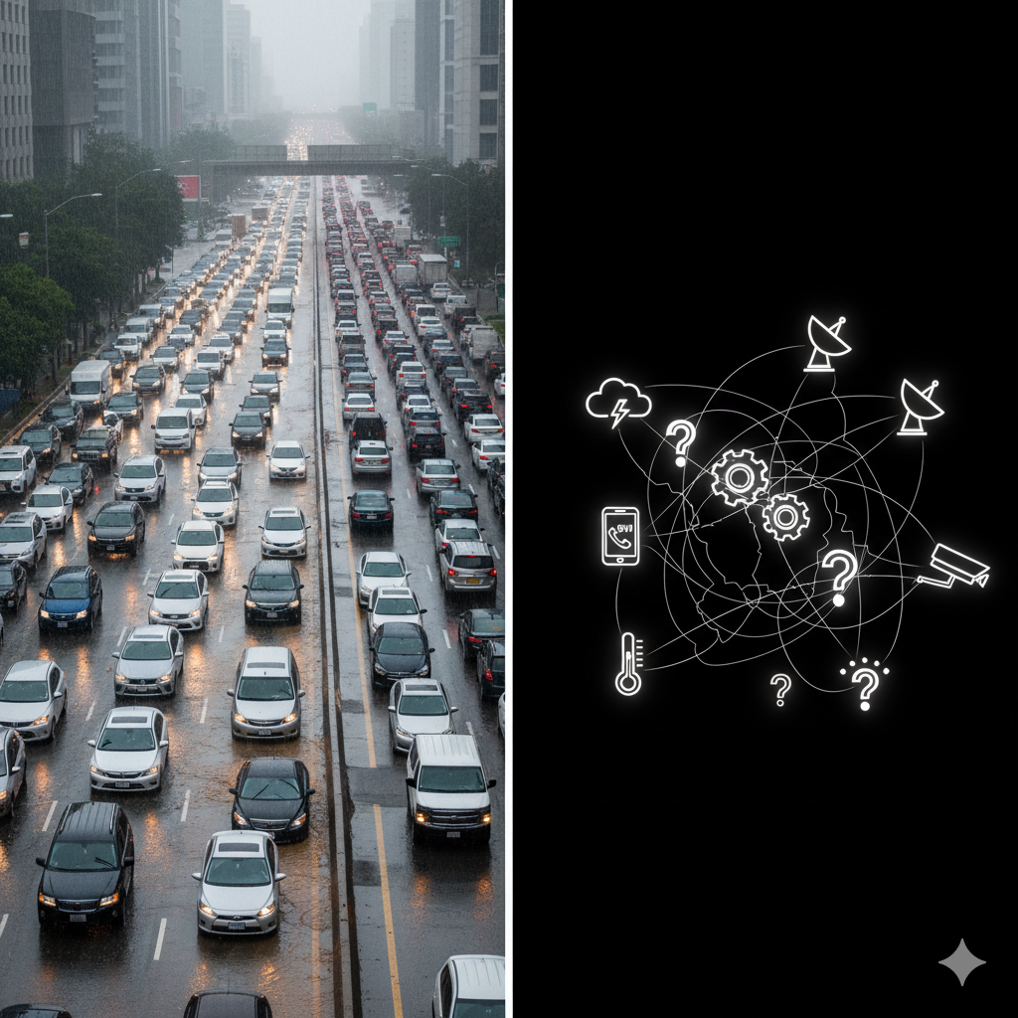
The Problem: (The “Before”)
“Delay kills. Confusion feeds chaos.”
Fragmented data sources and systems
Slow decision-making processes
Limited coordination between agencies
Average urban response delay: 10–15 mins
Lack of auditability and learning mechanisms

Slide 3
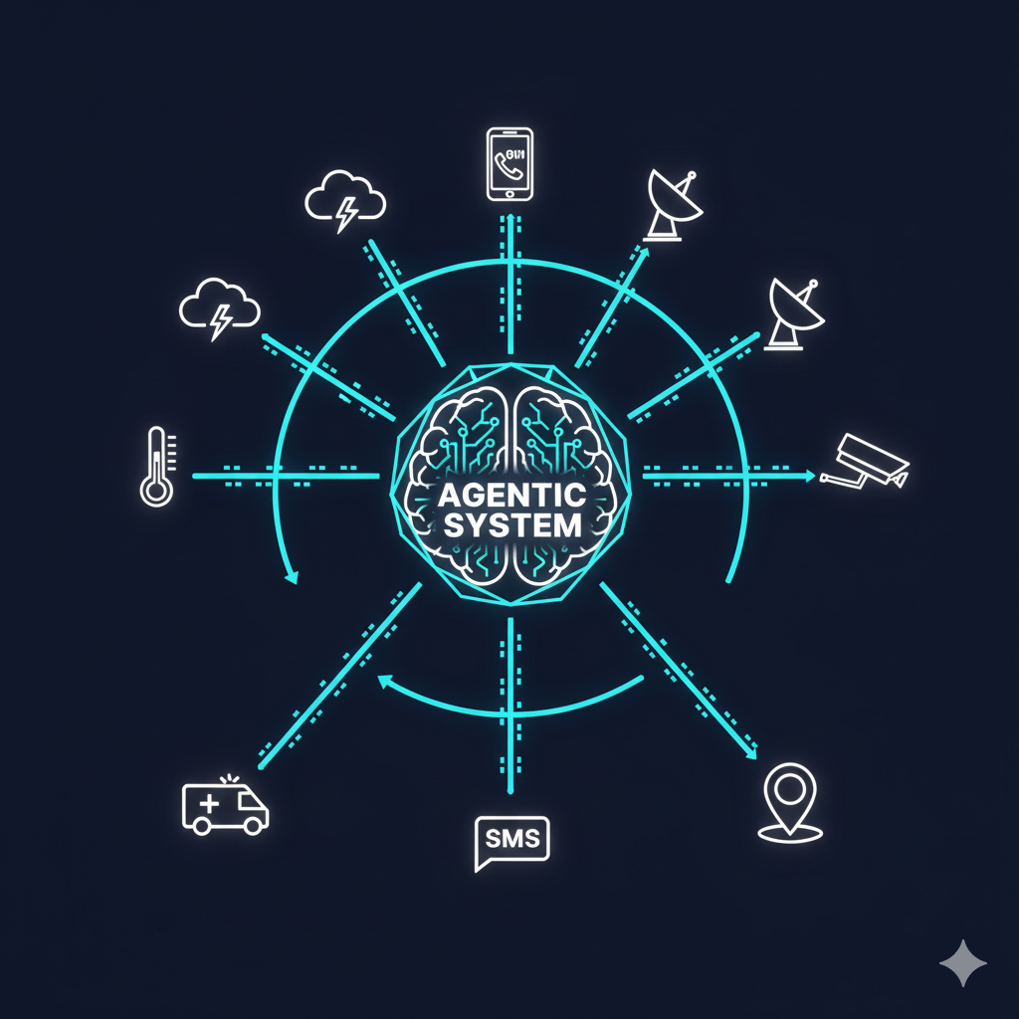
The Solution (The "After")
We're Building the Nervous System for the City.
10 specialized AI agents (for now) working in coordination
From data collection to automated response
Human-in-the-loop validation for approving responses
Full auditability with evidence bundles
Continuous learning from every event

Slide 4

How it Works – Agentic Architecture
Feed Collector
Data Normalizer
Learning Agent
Event Detector
Human Validator
Privacy Manager
{
"trace_id": "msg-pollen-1",
"topic": "events.detected",
"event_type": "flood_detected",
"confidence": 0.92,
"lat": 24.8607,
"lon": 67.0011,
"recipients": ["all"]
}
Communicator
Impact Assessor
Logistics Agent
Resource Recommender
Image by Amrulqays Maarof from Pixabay

Slide 5
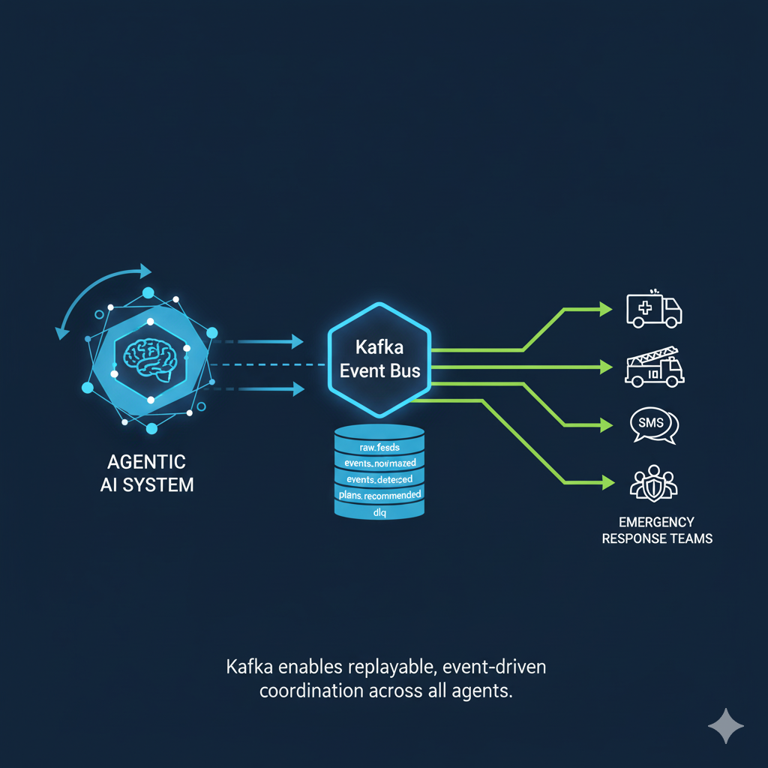
Make it Event Driven
“Kafka ensures replayable event streams — this system never sleeps.”
[
{
"id": "msg-flood-1",
"channel": "sms",
"body": "Flood Risk Alert for Suining County! Index 56. Be aware of localized flooding, especially in low-lying areas. Avoid flooded roads. Monitor local news for updates.",
"recipients": ["Emergency Services", "all", "Public Works"]
},
{
"id": "msg-pollen-1",
"channel": "sms",
"body": "High Tree Pollen Count (194) in Suining County. Allergy sufferers advised to limit outdoor activity and take precautions. Consult a doctor if symptoms worsen.",
"recipients": ["all", "Health Services"]
},
]

Slide 6
What sets this project apart.
End-to-end agentic orchestration: Complete workflow automation
Graceful degradation: System remains functional during outages
Per-Exec Evidence bundles: Full audit trail for every decision
Replayable event streams: Perfect for testing and post-event analysis
Human-AI collaboration: Critical decisions validated by experts
Privacy-first design: Built-in consent management and PII protection

Slide 7

The Secret Sauce
sensor.csv tweets.json impact.json trace.log approval.json
Fully Auditable
Always Reliable
verifier.zip (150 KB)
Trust by Design

Slide 8
Measurable Improvements
.
(Real-time + Simulated data)
72% events automatically resolved
Response time reduced 12 to 3 min
Continuous improvement through learning feedback loop
Scalable from neighborhood to city-wide deployment
Comprehensive audit trails for compliance

Slide 9

The Vision
A redundent Event Driven System.
Agentic Systems working around the clock, handling matters.
Once a significant event occurs, the systems alters a topic It notifies the human supervisor for approval.
Once approved, the actions will be executed.

Slide 10
“Let's Build a More Resilient Future. Together”
GitHub
Name: Syed M. Ashhar
Linkedin: www.linkedin.com/in/syed-ashhar Contact #: 00923443156626
Syed M. Ashhar 29 October 2025

